Slide 1
Clustering Similar African Cities using the Four-Square API

Slide 2
Introduction
Africa is a diverse region as it is home to many cultures, histories and peoples. The diversity can also be observed in the standard of living and economic growth in the different parts. In this project we will use the location of major African cities and he four square API to seek and cluster similar African cities to cities within the region.
BY clustering similar cities it can be possible to enhance travel and tourism recommendations. This will allow tourists to better plan their trips and have a 'feeling' of what to expect when visitng Africa. Secondly, Africa is an emerging region with abundant natural resouorces and a young population this presents an opportunity for investors looking for higher returns and a strong market positons or monopolies. With the clustering possible in this project tourists, investors and etc, can better understand African Cities what they have to offer and the opportunites arising there.

Slide 3
DATA
Our location Data will be retrieved from Simple Maps and Wikipedia. The data will provide the latitude and the longitude of most cities. The location will then be used to leverage Foursquare API to retrieve information on various venues around these locations. With the venue data and the location data we will the run a k-means algorithm to group cities with similar venues. With these clusters the Folium library will be used to plot similar cities.
The Clusters will be coloured and clearly labelled for peer-review. Secondly the Gross Domestic Product calculated for Purchasing Power parity and the populations will be used to produce GDP(PPP) per capita as a good proxy for the standard of living in these countries.
Thus the first data set from Simple Maps will have a coloumns for country, city, latitude, longitude. We shall the use a list of African countries retrieved from Wikipedia to filter our large list from Simple Maps. With this list We shall collect the locations for 150 venues in a 10km radius of the cities, this is possible with Four Squares API. Finally, the complete list will contian the city, country, latitude, longitude, 10 most common venues in a particulare city and the per capita purchaisng power parity.

Slide 4
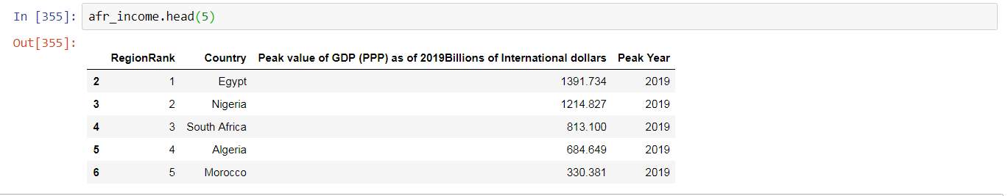
List of African Countries with Income

Slide 5
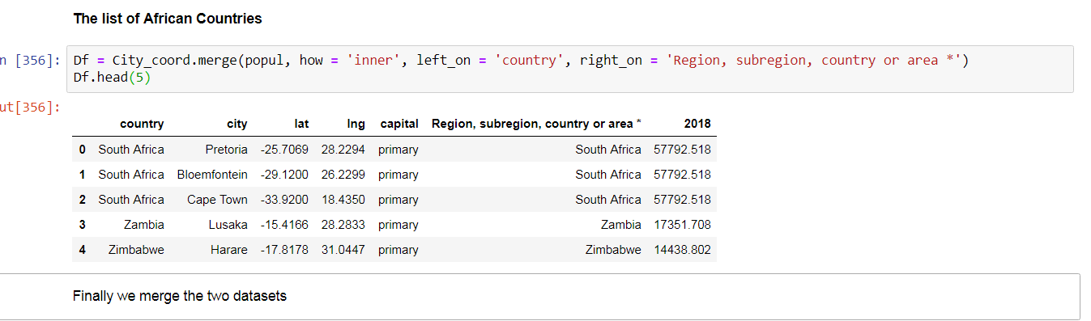
Location Data for Cities

Slide 6
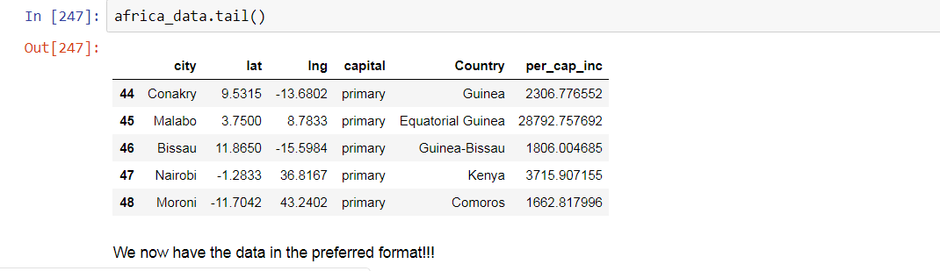
Final Table with location and income

Slide 7
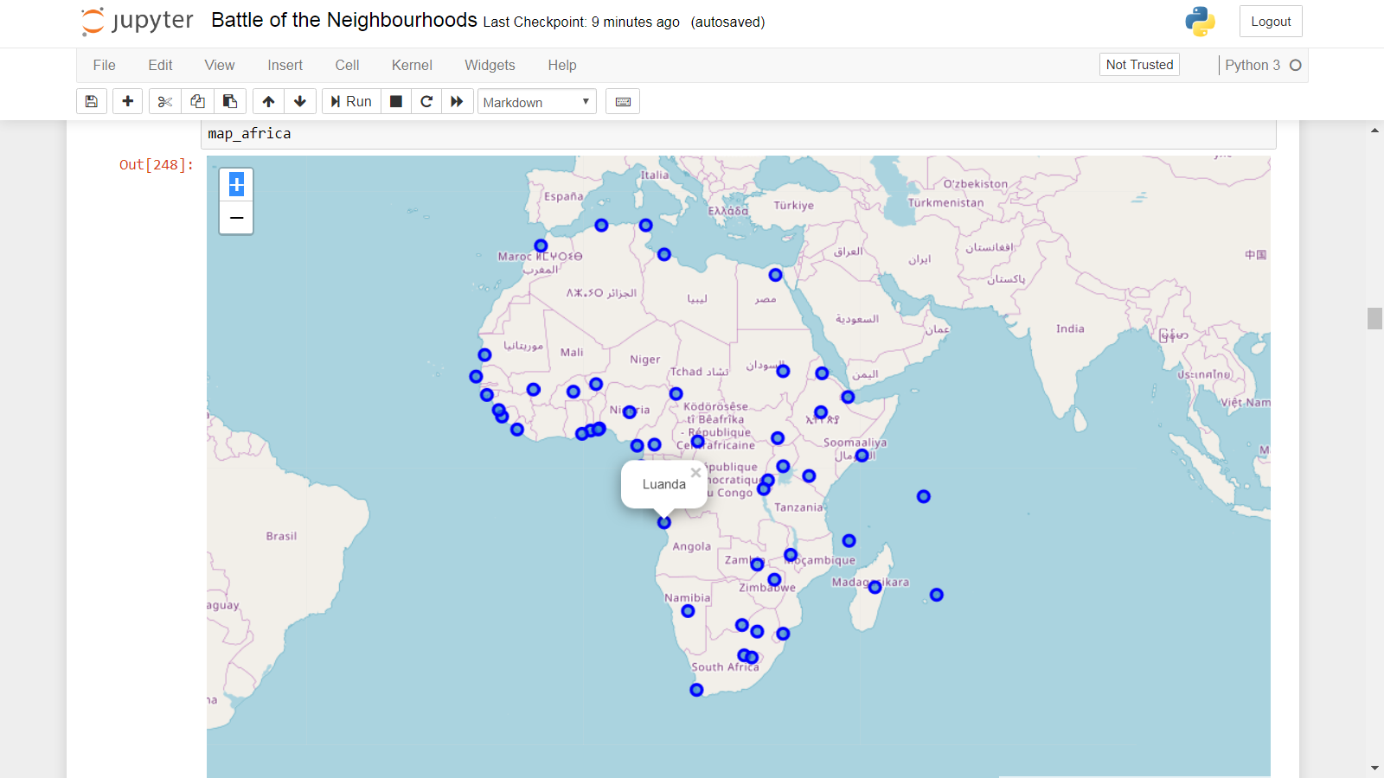
City Locations on Map

Slide 8
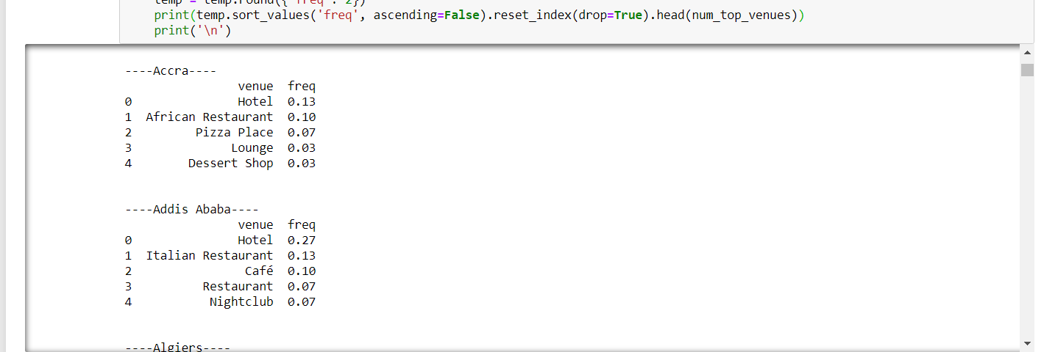
Information extracted and processed from FourSquare

Slide 9
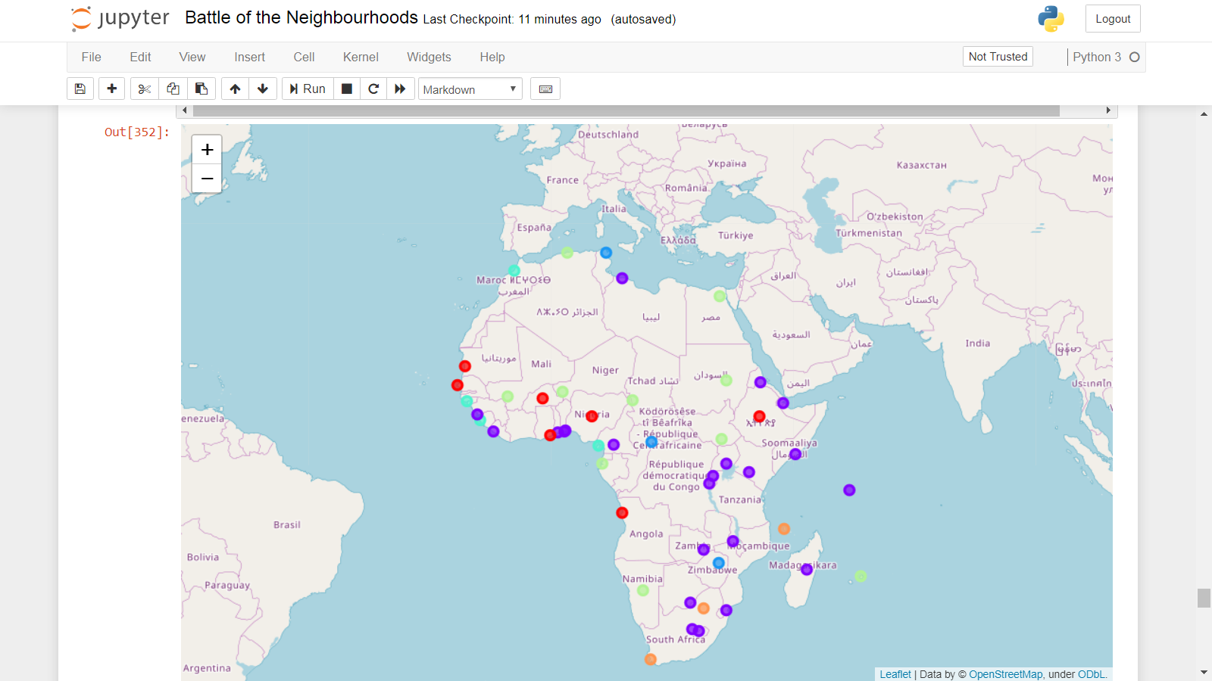
Final Clustering

Slide 10
Results and Discussion
The k means algorithm created seven clusters, with analysis it appears the clusters can be describe as follows:
1. Spanish Atlantic Coastal Cities- Morocco, Malabo, Freetown and Bissau
2. Ancient African trading Civilasations- Ethiopia, Nigeria, Angola, Ghana, Senegal and Burkina Faso
3. Desert regions with high incomes and small populations- Namibia, Chad, Egypt, Sudan, South Sudan, Niger, Mali and Gabon
4. High Income modern societies- Pretoria, Cape Town and Mauritius
5. Middle Income States mostly in ex British Africa-
6. Crisis States- Tunisia, Zimbabwe and the Central African Republic

Slide 11
Results and Discussion
It is worth noting they are few anomalies in thes classifications:
1. Freetown was not a spanish colony, and it has lower incomes the its group members, but it has been clustered with these cities. It would be intresting to discover these lingkages.
2. Tunisia is a high-income democracy unlike CAR and Zimbabwe
For the other groups the classification was nearly perfect considering the history, geography and politics of the regions.

Slide 12
Conclusion
The purpose of this project was to classify similar african cities for the purpose of tourism and investment. Thhis has been achieved through K-means clustering although a few anomalies exist, most clusteer hold true to reality.

